Slide 1
KIRCHHOFF’S LAW
LAWS COVERED:
Name : U.Gowtham Venkat Ram Santhosh
Roll No : 25A31A0151
Kirchhoff’s Current Law
Kirchhoff’s voltage Law

Slide 2

REQUIREMENTS
1. Hardware Requirements
Computer / Laptop
Keyboard and Mouse
Minimum 4 GB RAM
2. Software Requiremets
Compiler : GCC / Turbo C / IDE
Operating system : Windows / Linux
Programming Language : C/C++
Database (optional) : MySQL / File System

Slide 3
INTRODUCTION
Kirchhoff’s Laws are fundamental principles used in electrical circuit analysis. These laws help in determining the unknown values of current and voltage Kirchhoff’s Voltage Law (KVL) and Kirchhoff’s Current Law (KCL).
* KVL states that the algebraic sum of all voltages in a closed loop of a circuit is equal to zero, which follows the conservation of energy.
* KCL states that the algebraic sum of currents entering a junction is equal to the sum of currents leaving the junction, representing the conservation of charge.

Slide 4
ALGORITHM
STEP-1: Start the program.
• Initialize required variables and arrays.
• Display the title “Verification of KVL and KCL”.
STEP-2: Display the menu with two choices:
• Option 1 → Verify Kirchhoff’s Voltage Law (KVL)
• Option 2 → Verify Kirchhoff’s Current Law (KCL)
• Prompt the user to enter their choice.
STEP-3: Read the user’s choice and store it in the variable choice.
STEP-4: If choice = 1 (KVL selected), then:
a) Ask the user to enter the number of voltage elements “n”.
b) Input the value of “n”.
c) Prompt the user to enter n voltages representing voltage rises (+) and drops (–).

Slide 5
d) Read all voltage values into the array.
STEP-5: Calculate the algebraic sum of all entered voltages:
a) Initialize sum ← 0.
b) Traverse the voltage array from index 0 to n−1.
c) Add each voltage to variable sum.
STEP-6: Check the KVL condition:
a) If sum == 0, display message: “KVL Verified: Sum of voltages = 0”.
b) Otherwise, display: “KVL Not Satisfied: Sum of voltages ≠ 0”.
STEP-7: If choice = 2 (KCL selected), then:
a) Ask the user to enter number of entering currents (n1).
b) Read n1 current values and store them in array in.
c) Ask the user to enter number of leaving currents (n2).
d) Read n2 current values and store them in array out.

Slide 6
STEP-8: Compute total entering and leaving currents separately:
a) Initialize variables Sum(in) = 0 and Sum(out) = 0.
b) Sum all currents in in[] and store in Sum(in).
c) Sum all currents in out[] and store in Sum(out).
STEP-9: Check the KCL condition:
a) If Sum(in) == Sum(out) → Print “KCL Verified: Sum of entering currents = Sum of leaving currents”.
b) Else → Print “KCL Not Satisfied: Current sum mismatch”.
STEP-10: If the user chooses neither 1 nor 2, print “Invalid Choice”.
• Stop all operations and terminate the program.
• End the program execution.

Slide 7
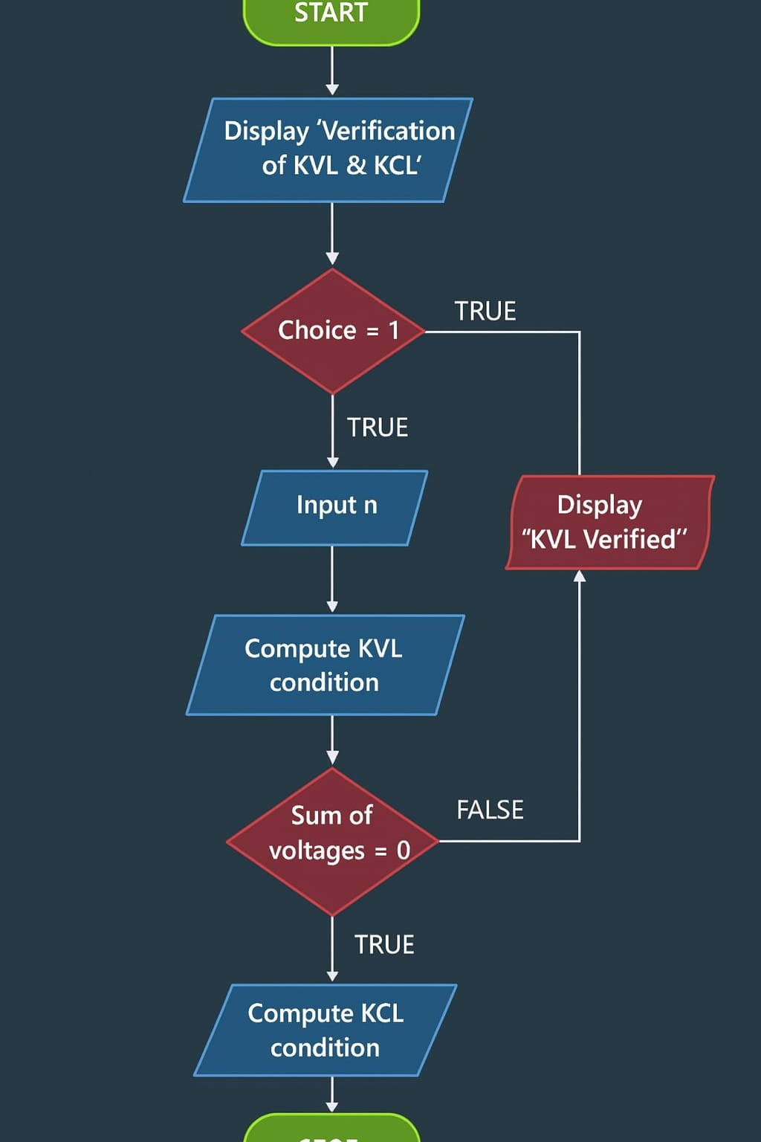
FLOWCHART

Slide 8

MODULE WISE LOGIC
Module | Logic
M1 → | Use arrays to store user inputs
M2 → | Loop to sum voltages and check if result ≈ 0
M3 → | Check if entering current sum equals leaving
M4 → | Use conditionals to print result

Slide 9
FORMULAS
KVL : ΣV = 0 (Voltage Sum in Loop)
KCL : ΣI(in) = ΣI(out) (Current Sum at Junction)
C Program
→ Program contains arrays & conditional statements to check both KVL & KCL.
→ Main integrates modules and prints final verification

Slide 10

Module-wise Program
void inputArray(float a[], int n) {
for(int i = 0; i < n; i++)
scanf("%f", &a[i]);
}
int verifyKVL(float v[], int n) {
float sum = 0;
for(int i = 0; i < n; i++)
sum += v[i];
return (sum == 0);
}
int verifyKCL(float in[], float out[], int n1, int n2) {
float sin = 0, sout = 0;
for(int i = 0; i < n1; i++) sin += in[i];
for(int i = 0; i < n2; i++) sout += out[i];
return (sin == sout);
}

Slide 11
Each module is executed individually to verify that it performs its assigned task correctly. The input module reads the circuit values, the KVL module calculates the algebraic sum of voltages, the KCL module calculates the algebraic sum of currents, and the output module displays the results to the user.
Once every module produces the expected output, they must be linked together in the final program. The flow of data between modules is planned so that intermediate results are correctly transferred without loss. During this integration process, errors such as mismatched data types, missing inputs, and logical inconsistencies are also resolved.
When all modules work together smoothly from input to final result, the program is said to have successfully completed module integration.

Slide 12

Modules Integration (Full Program)
#include <stdio.h>
void inputArray(float a[], int n) {
for(int i = 0; i < n; i++)
scanf("%f", &a[i]);
}
int verifyKVL(float v[], int n) {
float sum = 0;
for(int i = 0; i < n; i++)
sum += v[i];
return (sum == 0);
}
int verifyKCL(float in[], float out[], int n1, int n2) {
float sin = 0, sout = 0;
for(int i = 0; i < n1; i++) sin += in[i];
for(int i = 0; i < n2; i++) sout += out[i];
return (sin == sout);
}

Slide 13
int main() {
int choice, n, n1, n2;
float arr[10], in[10], out[10];
printf("1. Verify KVL\n2. Verify KCL\nEnter choice:");
scanf("%d", &choice);
if(choice == 1) {
printf("Enter number of voltages:");
scanf("%d", &n);
printf("Enter voltages (+rise, -drop):");
inputArray(arr, n);
if(verifyKVL(arr, n))
printf("KVL Verified: Sum of voltages = 0\n");
else
printf("KVL Not Satisfied\n");
}
else if(choice == 2) {
printf("Enter number of entering currents:");
scanf("%d", &n1);
printf("Enter entering currents:");
inputArray(in, n1);

Slide 14
printf("Enter number of leaving currents:");
scanf("%d", &n2);
printf("Enter leaving currents:");
inputArray(out, n2);
if(verifyKCL(in, out, n1, n2))
printf("KCL Verified: Sum(in) = Sum(out)\n");
else
printf("KCL Not Satisfied\n");
}
else
printf("Invalid Choice");
}
Execution Steps
→ Compile the C program
→ Run the executable
→ Choose option 1 (KVL) or 2 (KCL)
→ Enter values as prompted
→ Observe result printed on screen

Slide 15
Sample Output (KVL)
Verify KVL
2. Verify KCL
Enter choice: 1
Enter number of voltages: 3
Enter voltages: 5 -3 -2
KVL Verified: Sum of voltages = 0
Sample Output (KCL)
1 . Verify KVL
2. Verify KCL
Enter choice: 2
Enter number of entering currents: 2
Enter entering currents: 5 3
Enter number of leaving currents: 2
Enter leaving currents: 4 4
KCL Verified: Sum(in) = Sum(out)

Slide 16
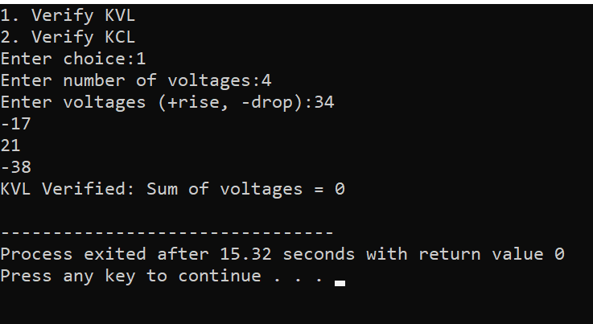
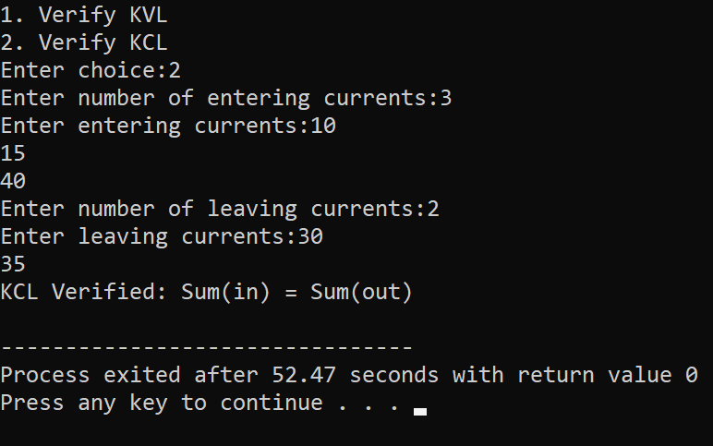
RESULT:

Slide 17
Conclusion
✔ KVL verified because voltage rises and drops balanced to zero
✔ KCL verified because sum of entering currents equals sum of leaving currents
This project demonstrates Kirchhoff’s laws through computation.

